Slide 1
Ryan Burdick
Jashan Chopra
Dominic Dougherty
Jason Magno
John Tucker
Donny Wolfe
ASEN 2004
March 6th, 2019
Final Design Review:
The Flying Fish
Notes:
Jashan: Introduction

Slide 2
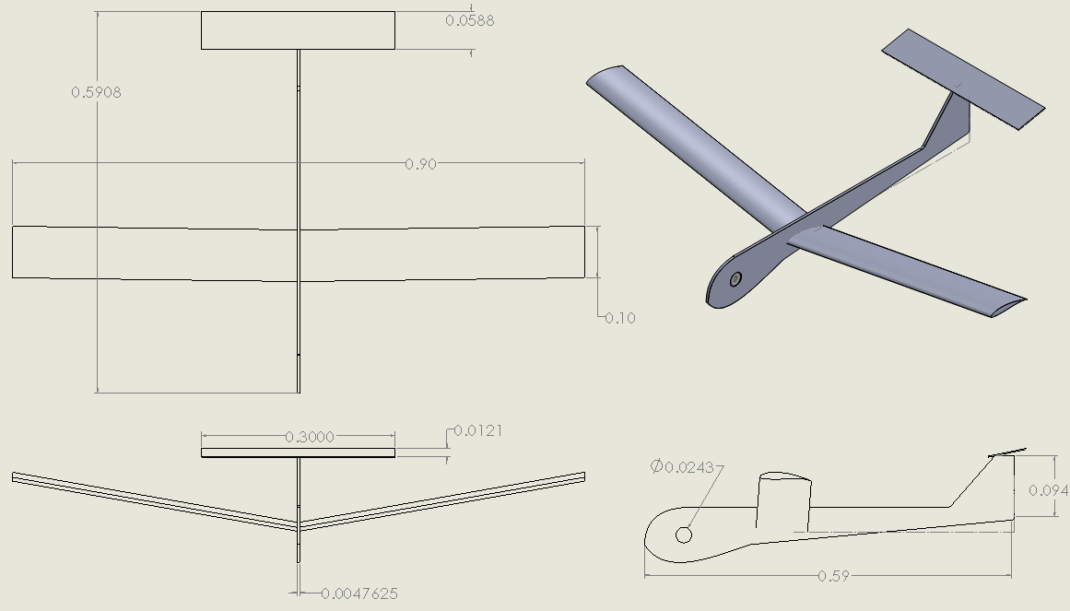
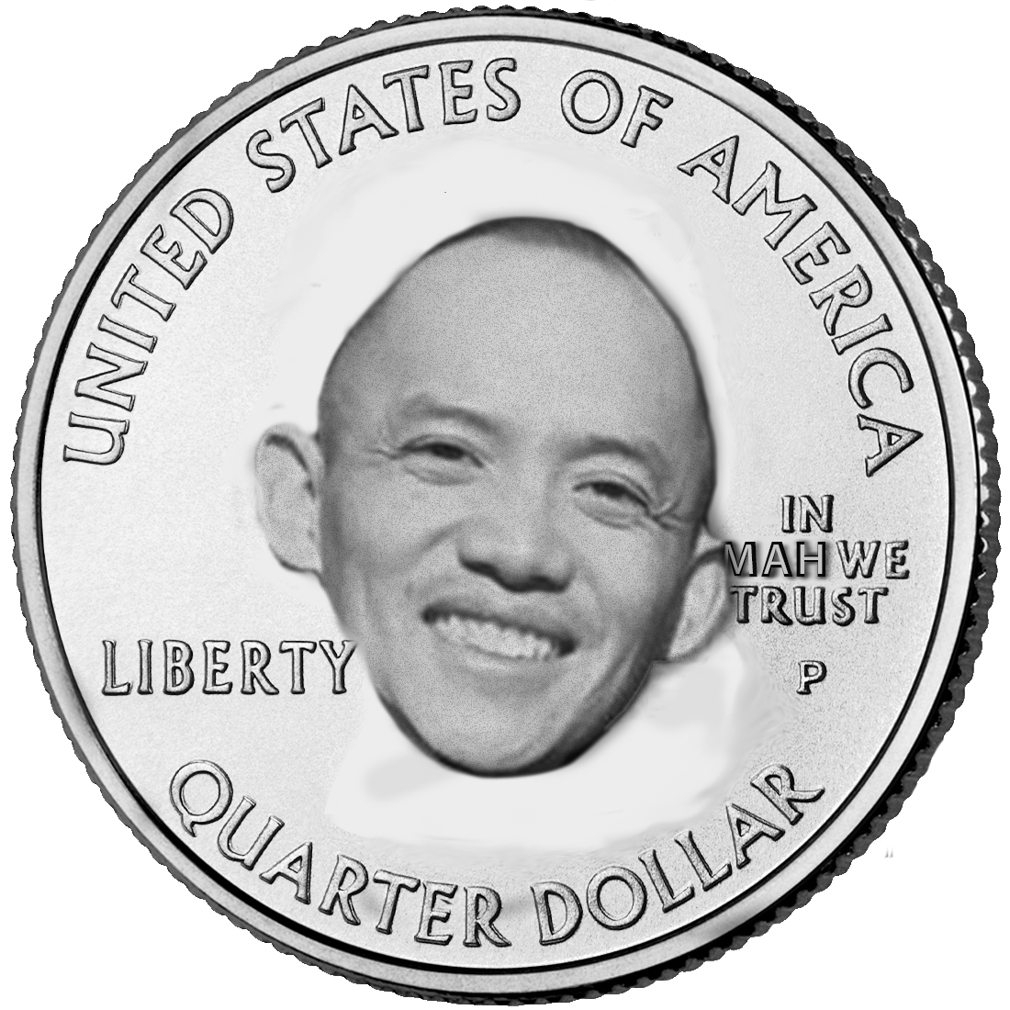
Layout & Design
Notes:
Jashan: Triview

Slide 3
Performance Characteristics
Wingspan | 0.9 m
Wing Area | 0.0951 m²
Aspect Ratio | 8.51
Chord Length | 10 cm
Airfoil | Wortmann FX 63-137-il
Length | 0.5908 m
Initial Mass | 78 grams
Center of Gravity | 19.5 (% chord)
Dihedral Angle | 10 degrees
Horizontal Tail Incidence Angle | 8 degrees
Notes:
Jashan: Solidworks modelling and introduction to flight performance.

Slide 4
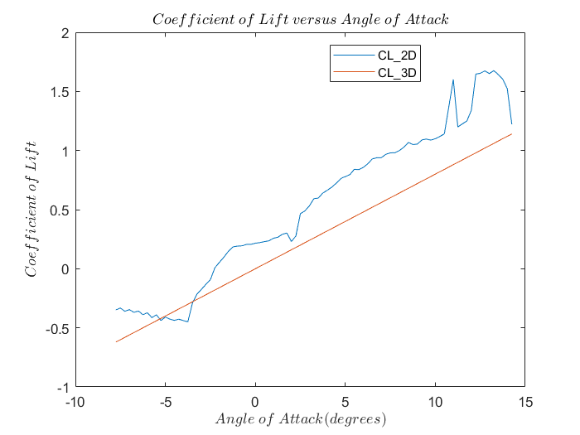
Lift Curve Plot - Wortmann fx 63-137
Initial data plots were taken from Airfoiltools.com, where the data values are at a Reynolds number of 50,000, the lowest provided.
The non-linearity of the lift curve plot and high Reynolds number contributed to error in performance analysis.

Slide 5
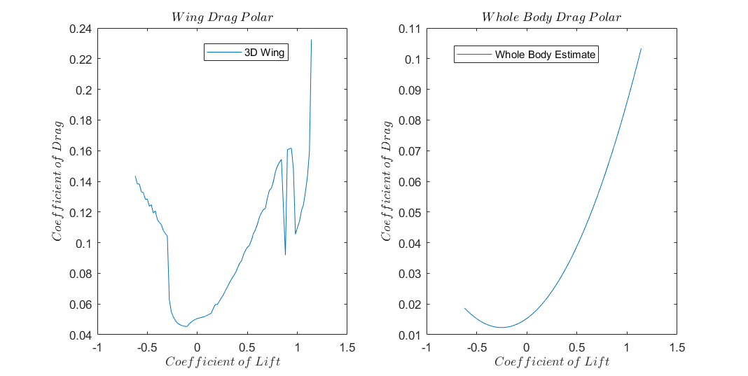
Drag Polar Plot & Equation
The large differences in 3D vs Whole Body Drag Polar plots come from model shortcomings in the computational lab.
Code predicts a max (L/D) larger than the expected value, and Solidworks Flow Simulation predicts one smaller than the expected measured value.

Slide 6
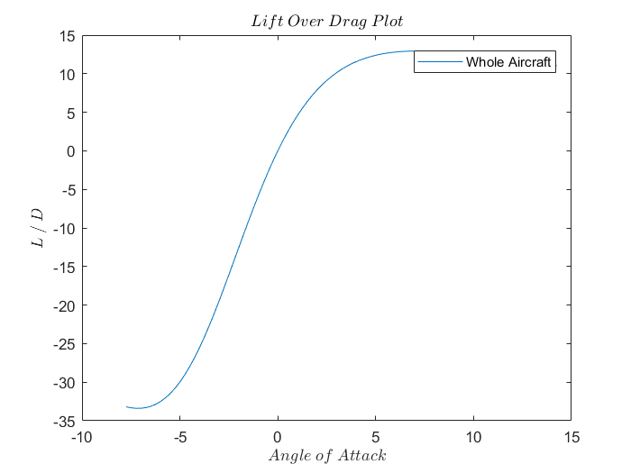
(L/D) v. Angle of Attack
Max (L/D):
Predicted:
MATLAB: 12.94
Solidworks: 4.75
Actual:
Best: 6.65
Worst: 2.82

Slide 7
Comparison of Flight Tests v. Predicted Data
 | Predicted (Comp Lab) | Predicted (Solidworks) | Actual (From outside flight)
Max Range | 82.8 [m] | 30.4 [m] | 18.1 m + 3.68 m height Extrapolation: 42.6 m
Max (L/D) | 12.94 | 4.75 | 2.82 (Assuming 18.1m) 6.65 (extrapolated)
Velocity at Max (L/D) | 3.92 [m/s] | 6.5 [m/s] (Tested at range of 2-7, increments of 0.5) | 4.57 [m/s] (extrapolated estimation)
Stall Velocity | 1.1 [m/s] | - | 2.77 [m/s] (estimation)

Slide 8
Inside
Flight

Slide 9
Outside
Flight

Slide 10
Performance
Code Analysis:
Both MATLAB and Solidworks Flow Simulation predicted >20 meters
Solidworks gave us better mass and CG estimations due to rectangular approx. in code
Unsure about the validity of Solidworks Flow Simulation Software
Stability Issues:
Coupled yaw and roll
Indoor flight: started to yaw left but crashed into the stairs on the right
Outdoor flight: yawed and rolled left into a tree
Unbalanced wings and a small Vv contributed to dynamic instability
Slight left coupled roll and yaw
Notes:
Our predictions from both MATLAB and Solidworks were good, we predicted a range >20 meters and performed adequate stability calculations. We felt Solidworks gave us better mass and CG estimations, but are unsure about the validity of the Flow Simulation software.
During testing our glider performed well, but we found a primary stability issue in yaw and roll. From the video, the plane yawed into the stairs, preventing a longer flight. Similarly, in the outdoors flight the plane yawed and rolled, but this time to the left and into a tree.

Slide 11
Failure Analysis
Structural Challenges:
Attachment of the wing to dihedral wedges
Wing spar attachment to airfoils due to low durability surface areas with glue
Foam fuselage could only withstand a limited amount of test flights
Unable to repair wing spar attachment to airfoils, would have required puncturing saran wrap
Sources of Error:
High reynolds number from airfoil tools led to inaccurate predictions → larger L/D, increased range, graph inaccuracies
Induced drag from design cannot be adequately modelled in MATLAB, which is why we combined Solidworks analysis
Stability issues result in lost range: difficulty in constructing the precise dihedral angle and alignment for both wings
Initially Unstable Dihedral

Slide 12
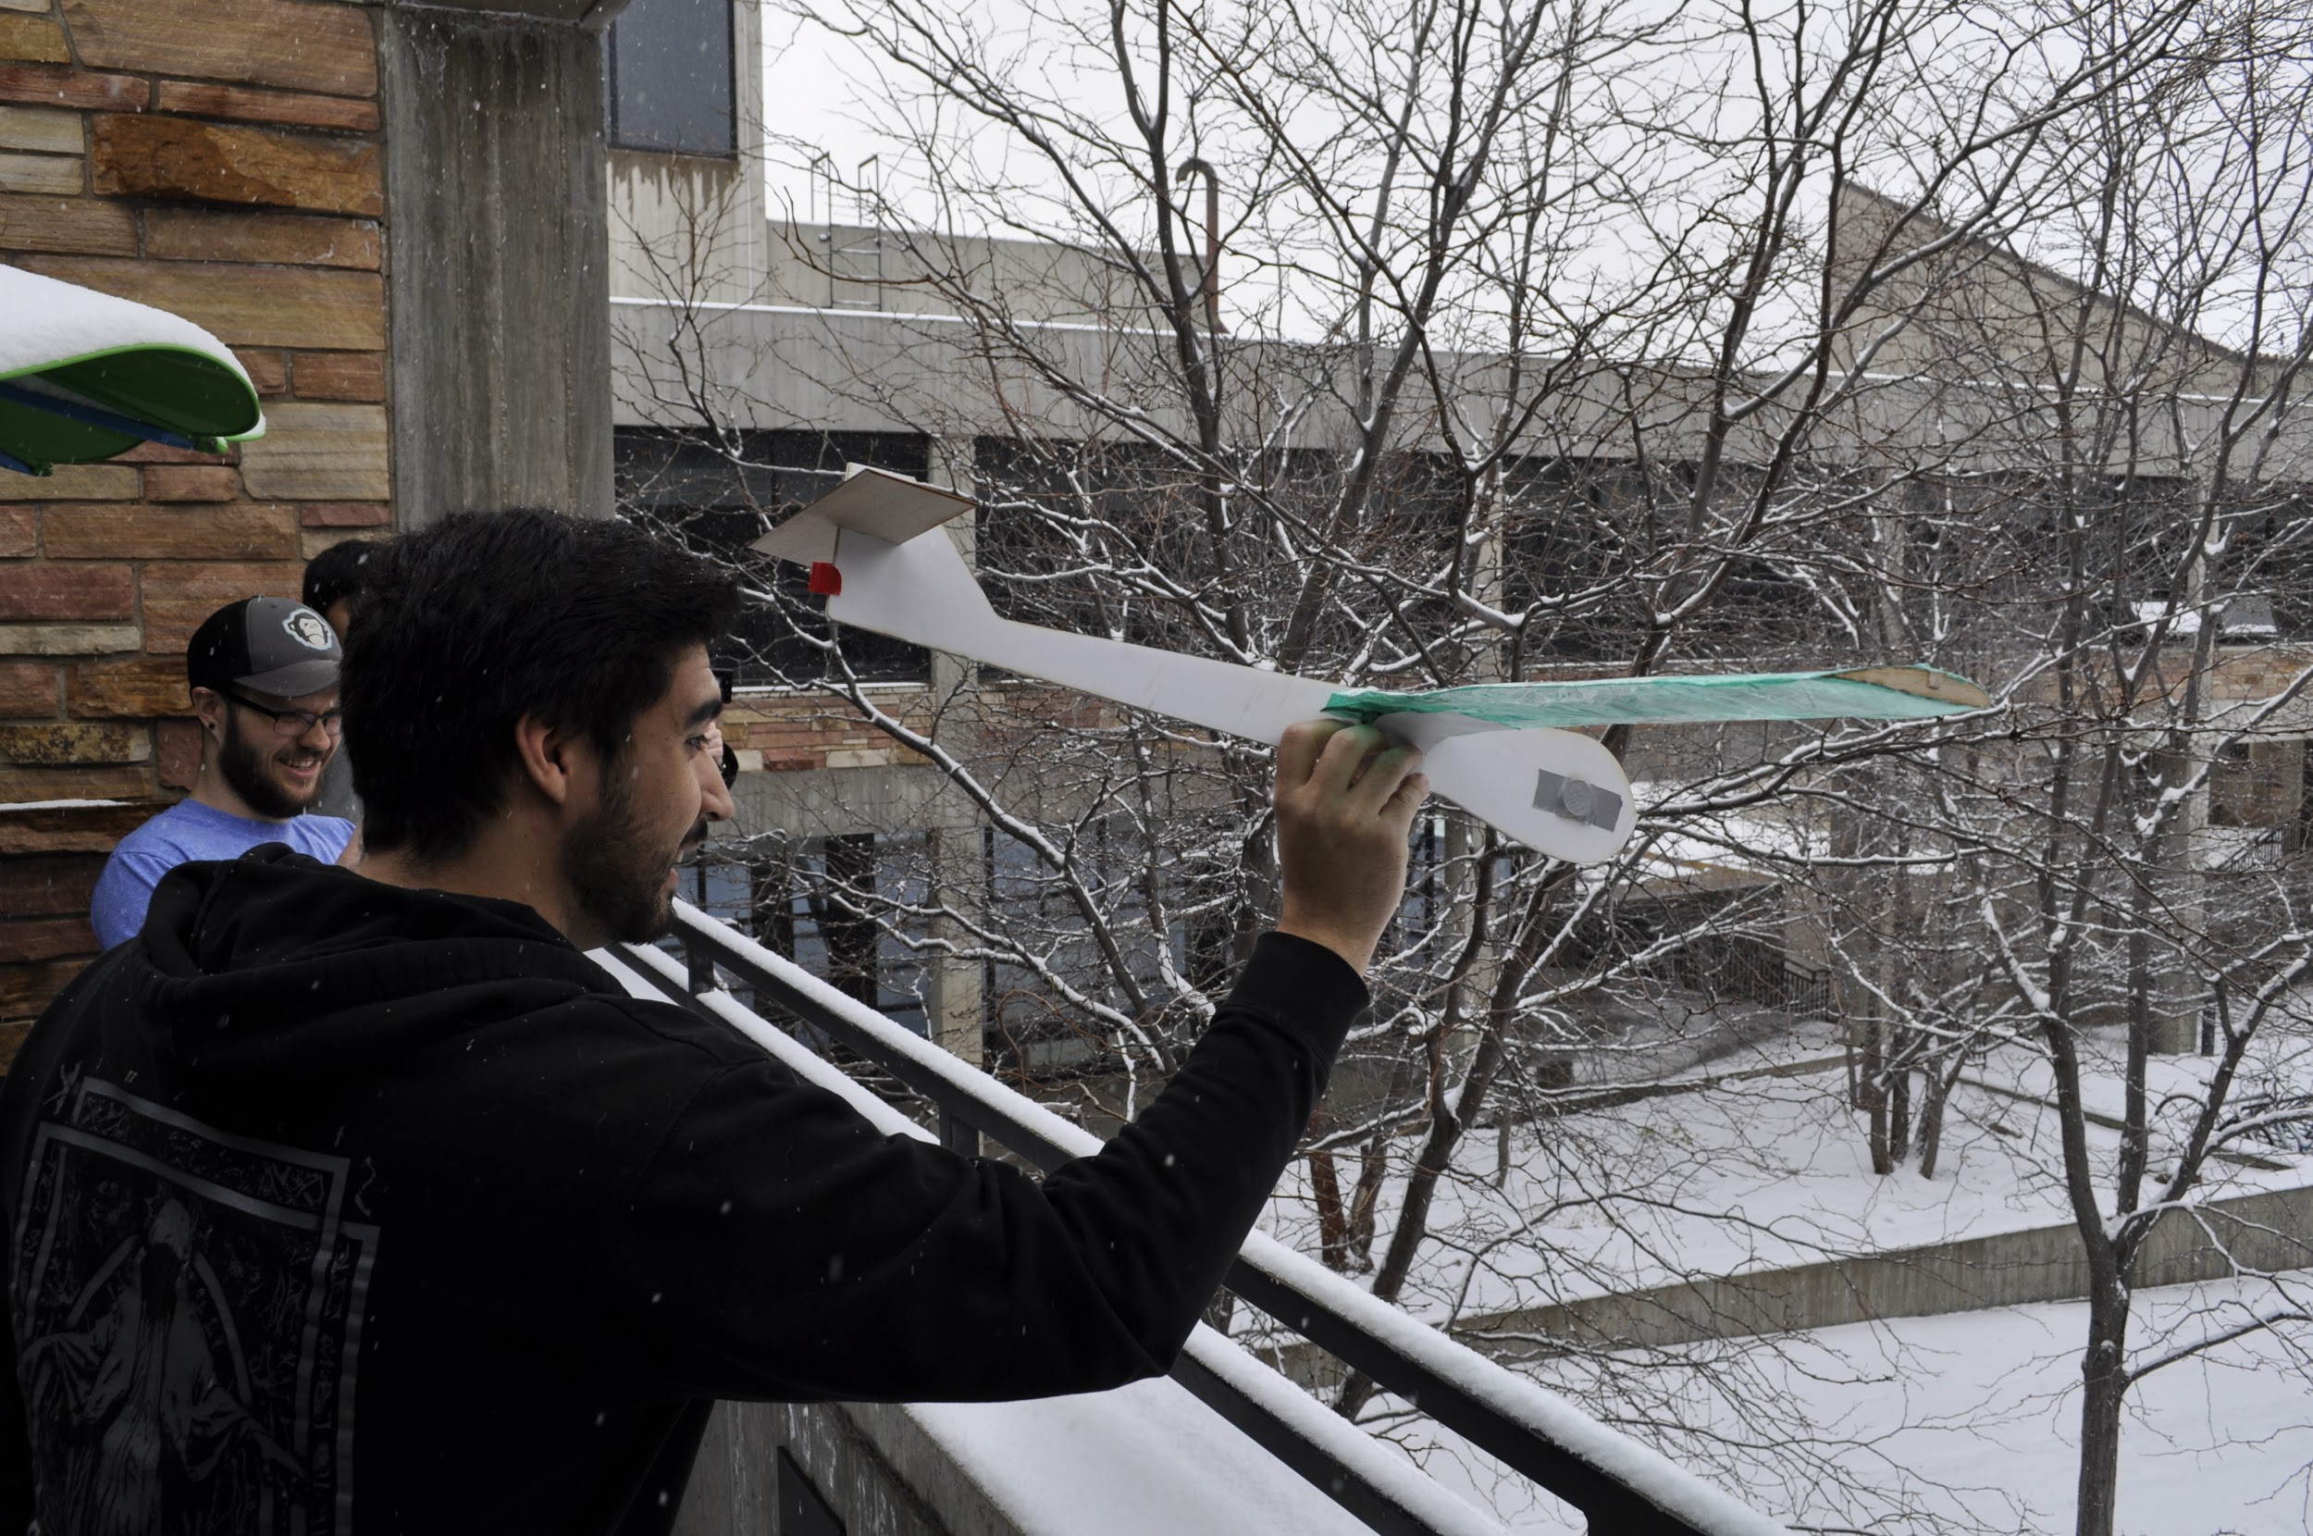
Learning Opportunities
Changes:
Make airfoil ribs out of a stronger material. 3D printed?
Construct entire spar from a single piece of balsa or perhaps an even stronger material.
Better balance of wing mass to improve roll stability, or larger dihedral.
Foam performed worse for cling wrap adhesion, but did decrease weight well and hold the shape well enough to be effective. Consider other light options to keep the camber better.
Reinforce the body to better withstand ground impacts.
Professional Toss Man Dom
We learned that small flaws and quick changes are bound to happen during construction and that flight tests always provide the ‘real’ picture of what happens. Manufacturing accuracy matters.

Slide 13
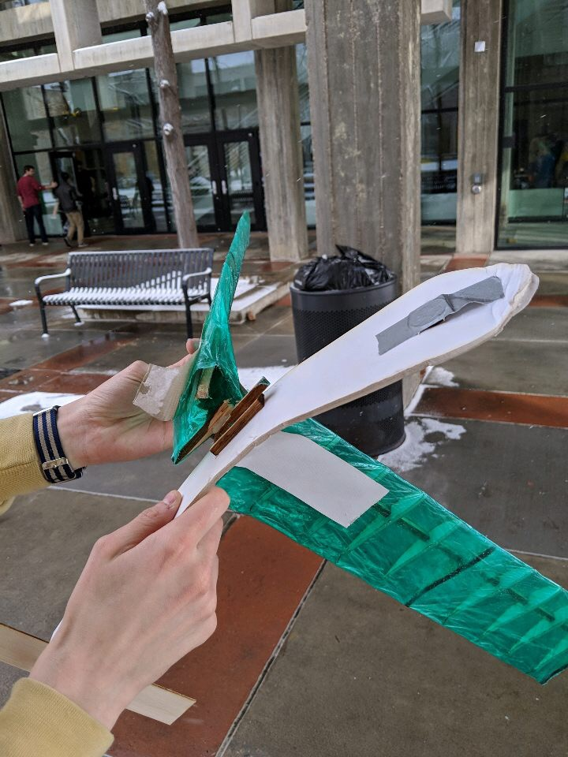
The Floppy Fish
Final Conclusions:
Always test with multiple sources and programs (CFD data, Flight data, MATLAB analysis, Solidworks analysis)
Develop modular solutions and easily changeable code for emergency fixes and rapid prototyping
A perfectly designed plan may not be possible to construct! It’s hard to balance best performance of all aspects between stability, range, structure, cost, weight, etc.

Slide 14
References
Mah, John. ASEN 2004 Aero Lab Part 1. 2019, pp. 1–16, ASEN 2004 Aero Lab Version 4
Anderson, J. D., Introduction to Flight, 8th Ed., McGraw Hill (2012).
G.K. Ananda, P.P. Sukumar, M.S. Selig, Measured aerodynamic characteristics of wings at low Reynolds numbers,Aerospace Science and Technology, Volume 42, 2015.
Mark Drela, Steven Hall, Paul Lagace, Ingrid Lundqvist, Gustaf Naeser, Heidi Perry, Raúl Radovitzky, Ian Waitz, Peter Young, and Jennifer Craig. 16.01 Unified Engineering I, II, III, & IV. Fall 2005 -Spring 2006. MIT: OpenCourseWare, https://ocw.mit.edu. License: Creative Commons BY-NC-SA.
Selig, M., University of Illinois at Urbana-Champaign Applied Aerodynamics Group, https://m-selig.ae.illinois.edu/index.html
https://pdfs.semanticscholar.org/0a4d/83a63a1e36ad66b69fd2ac9d20efc55cae23.pdf
http://airfoiltools.com/airfoil/details?airfoil=fx63137-il#polars
https://pdfs.semanticscholar.org/919a/c74eda18dcf6a27afb39920586c295bc6173.pdf

